Slide 1
Mid-Semester Update

Slide 2
Data set summary
7 species (6 Calanoids, 1 Cladoceran)
21 collections
514 thermal limits (not including today or tomorrow’s data!)

Slide 3
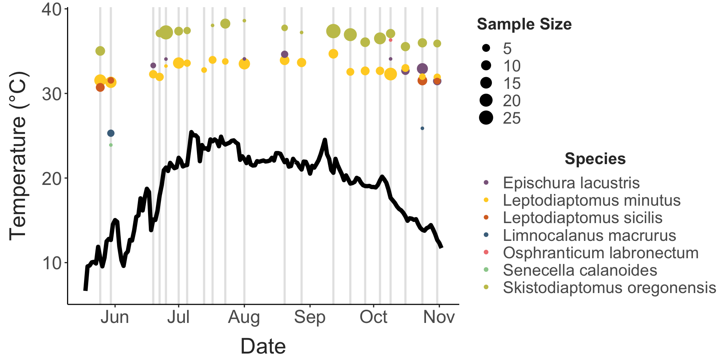
Thermal limits vs. time

Slide 4
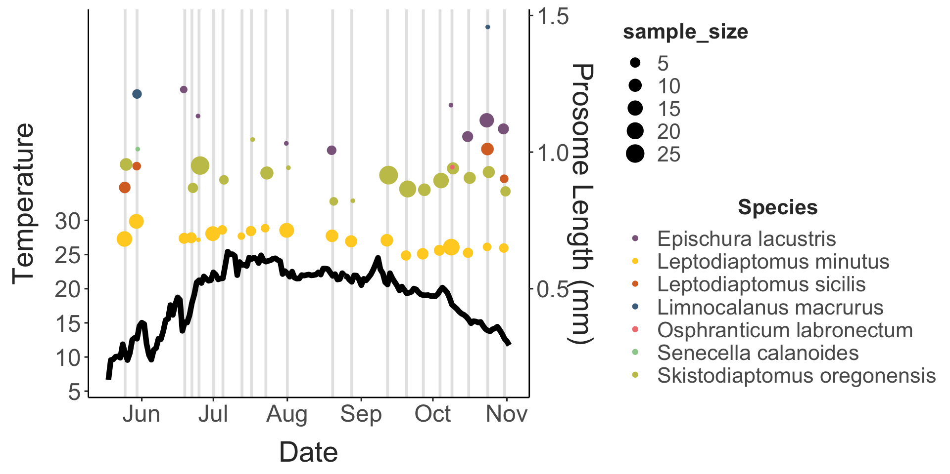
Other traits vs. time

Slide 5
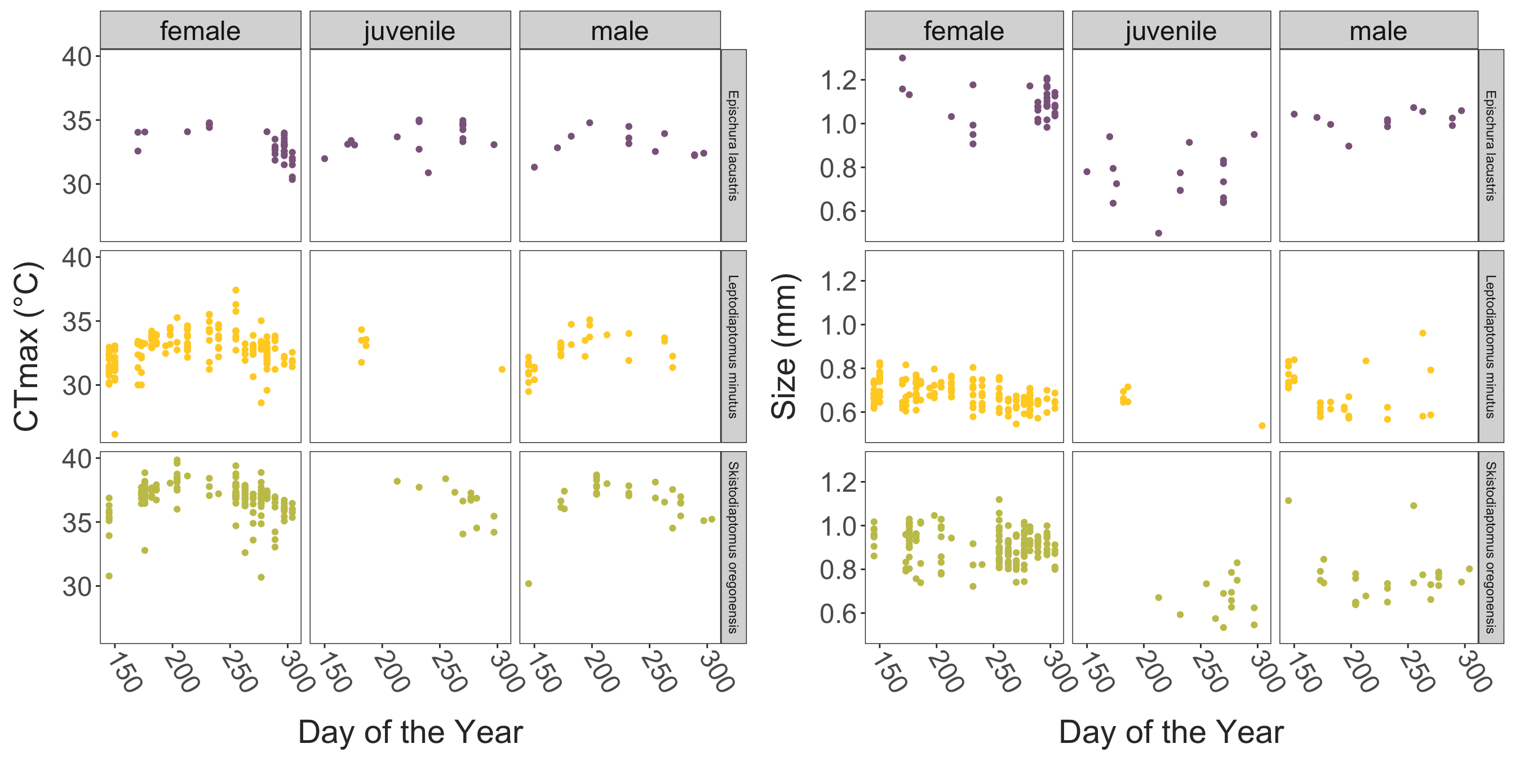
Other traits vs. time

Slide 6
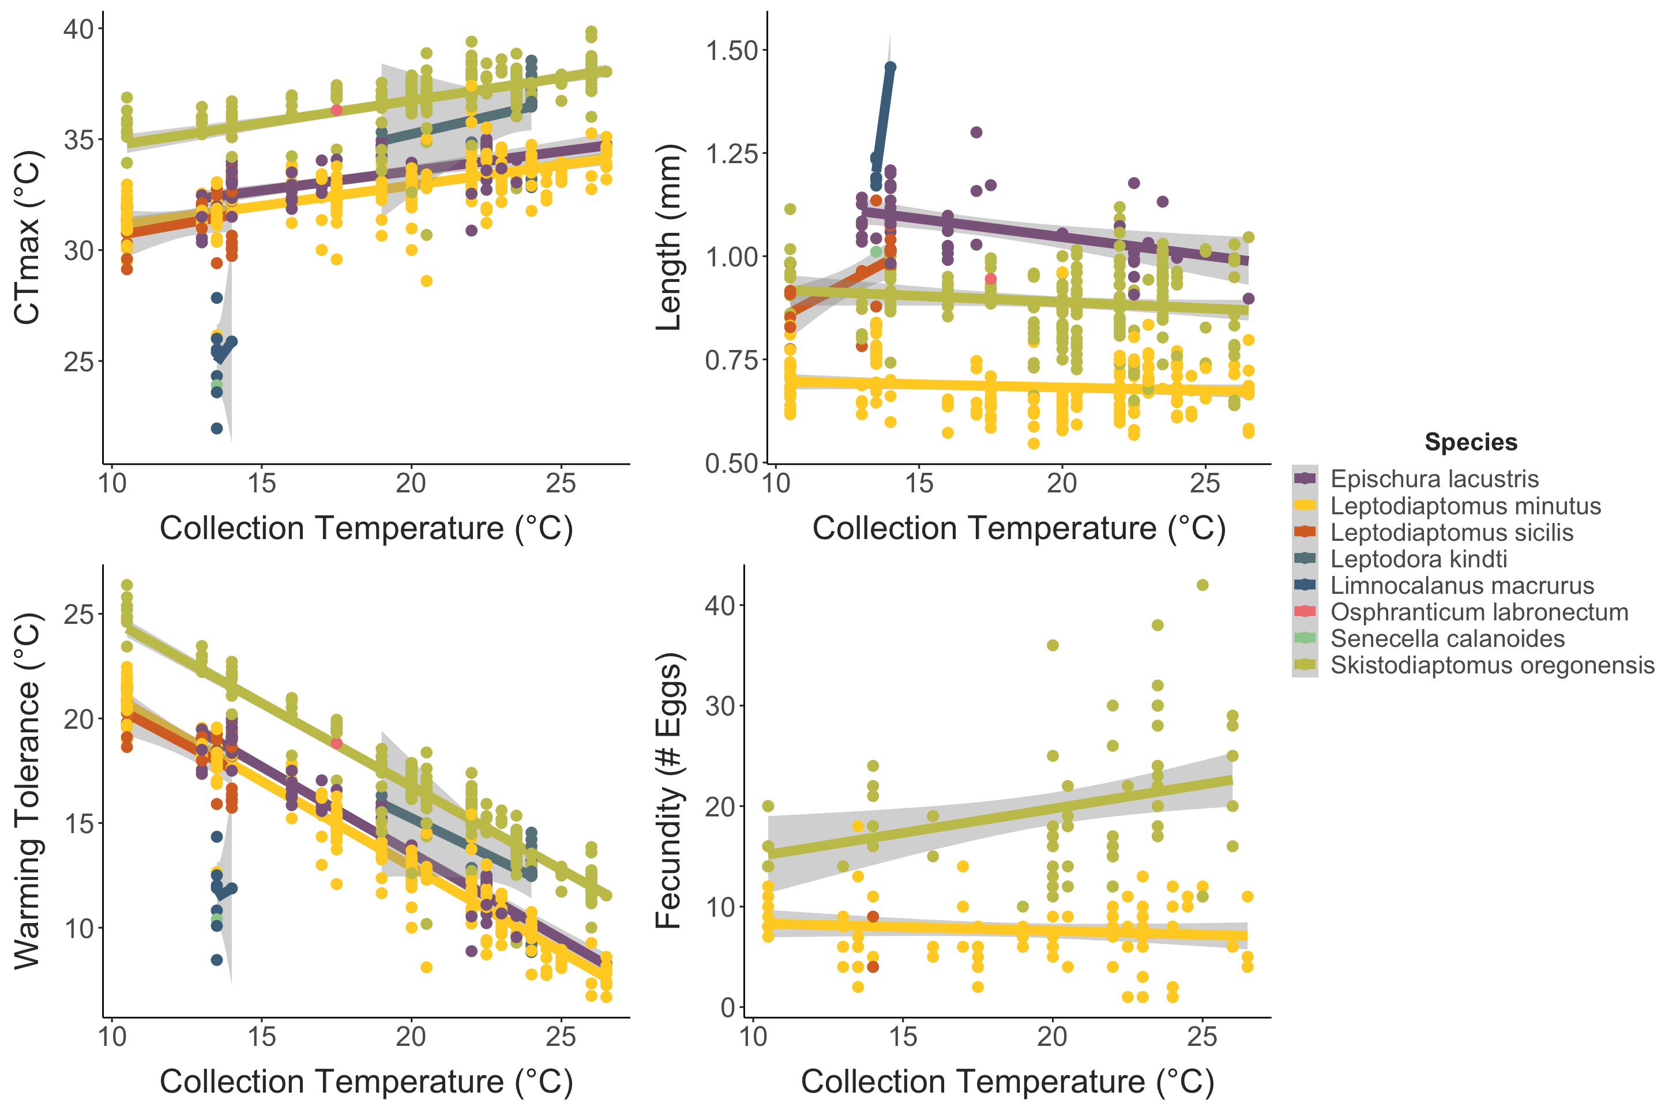
Temperature correlations

Slide 7
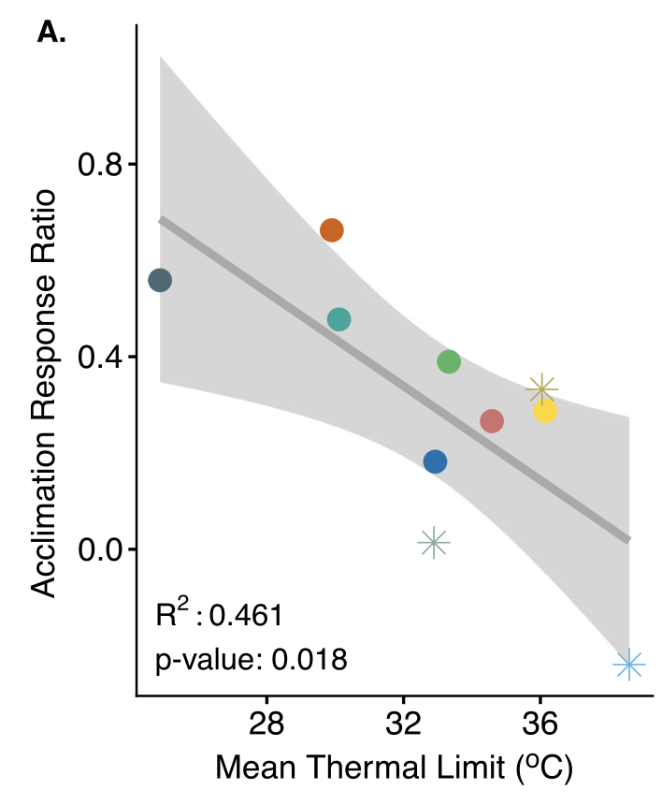
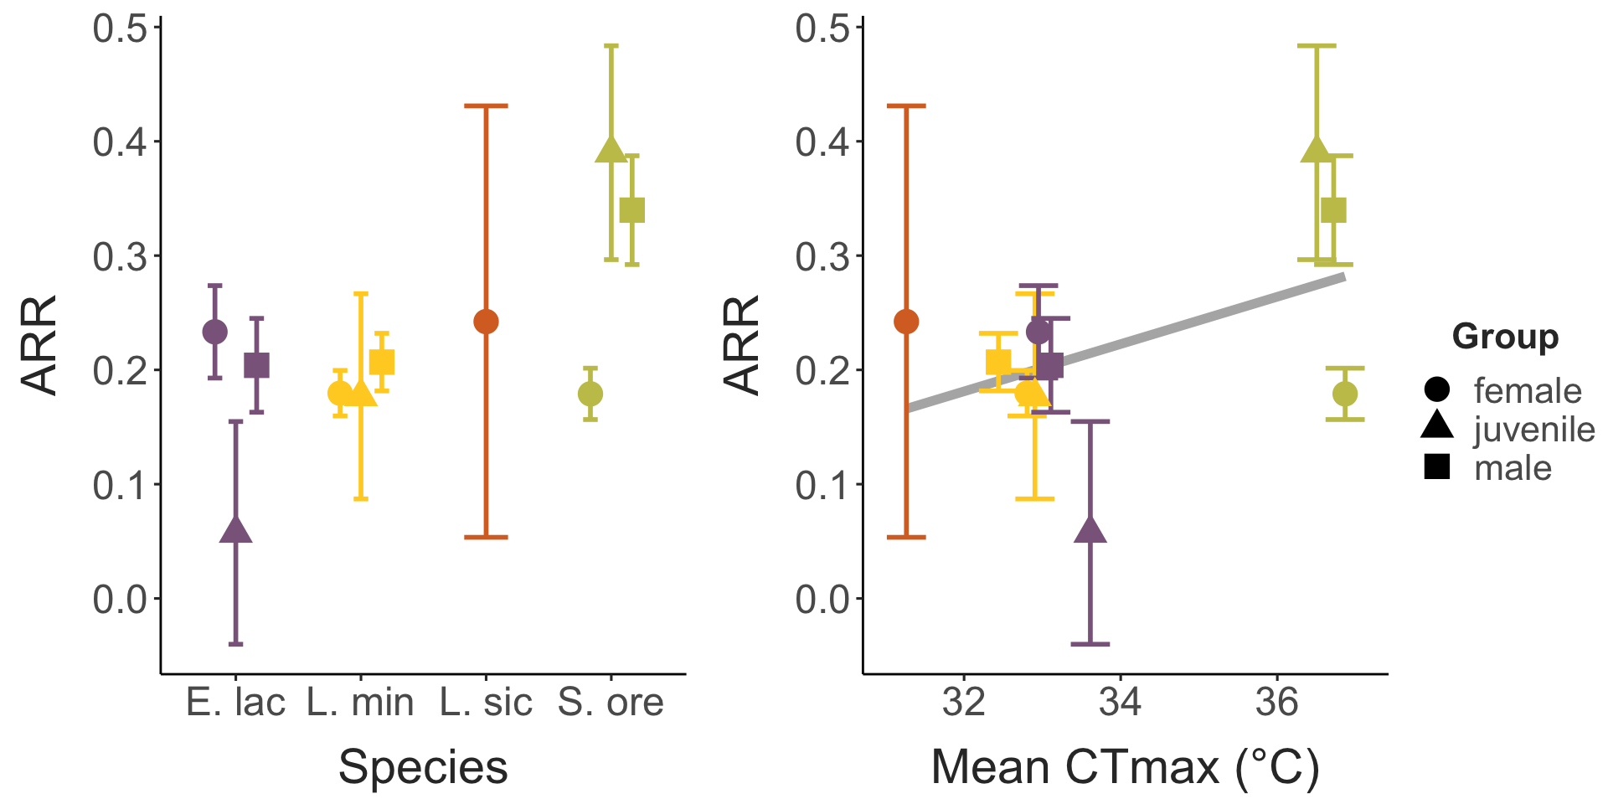
Acclimation response ratios

Slide 8
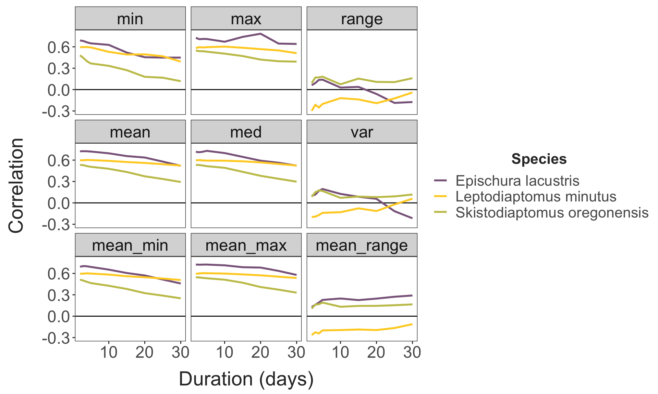
Other predictor variables

Slide 9
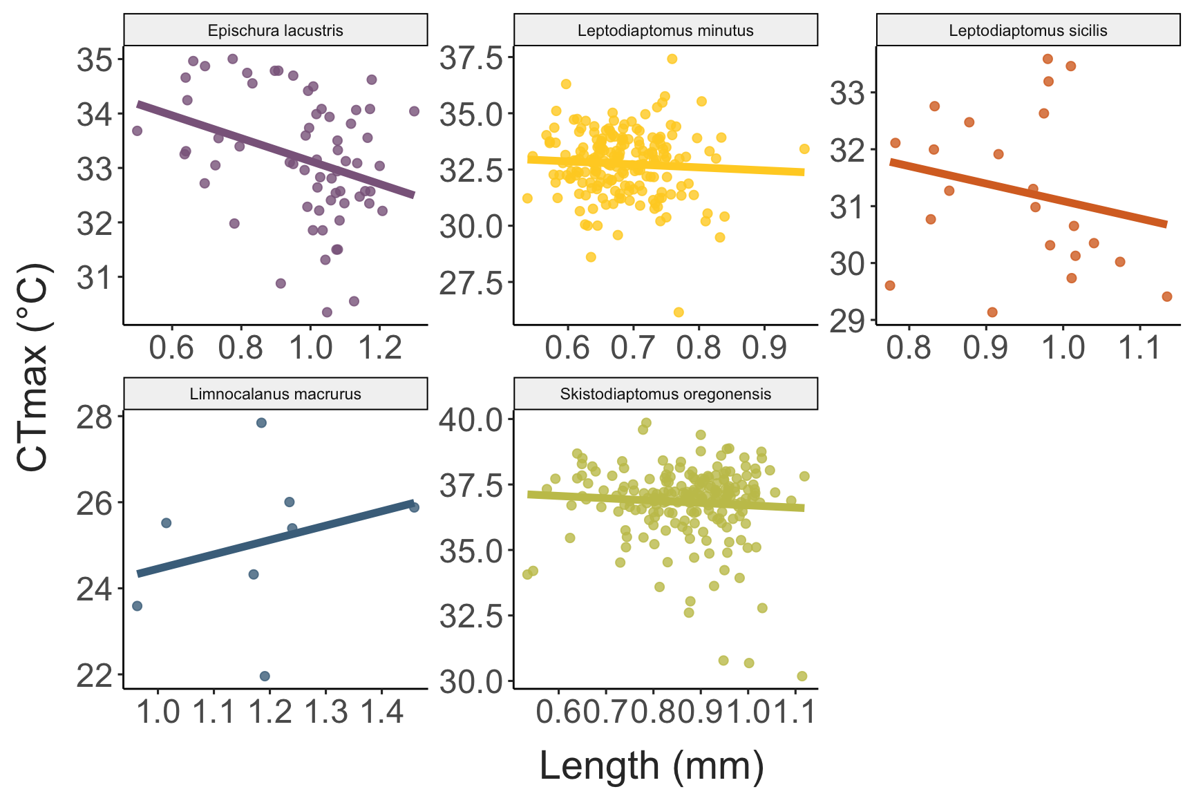
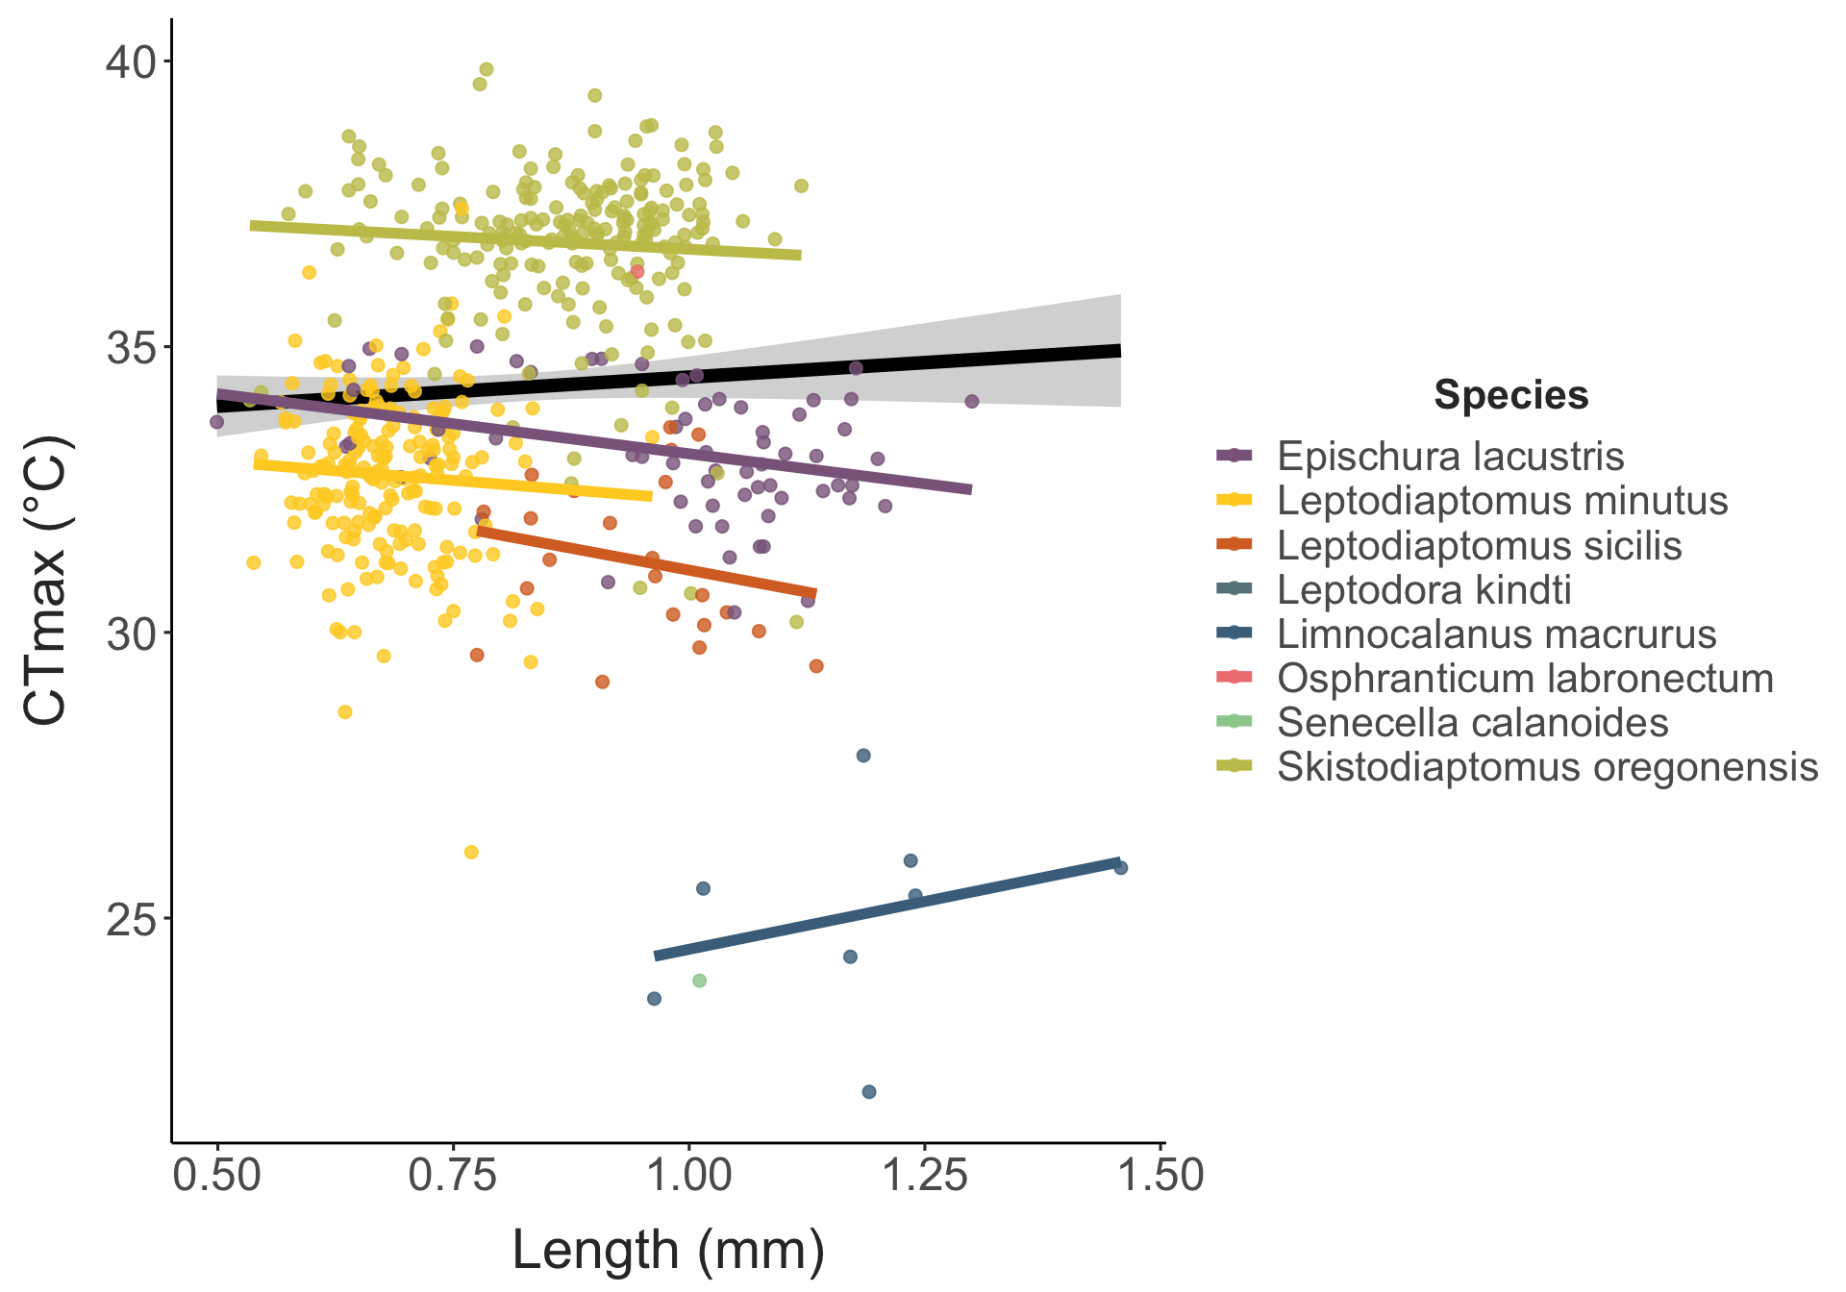
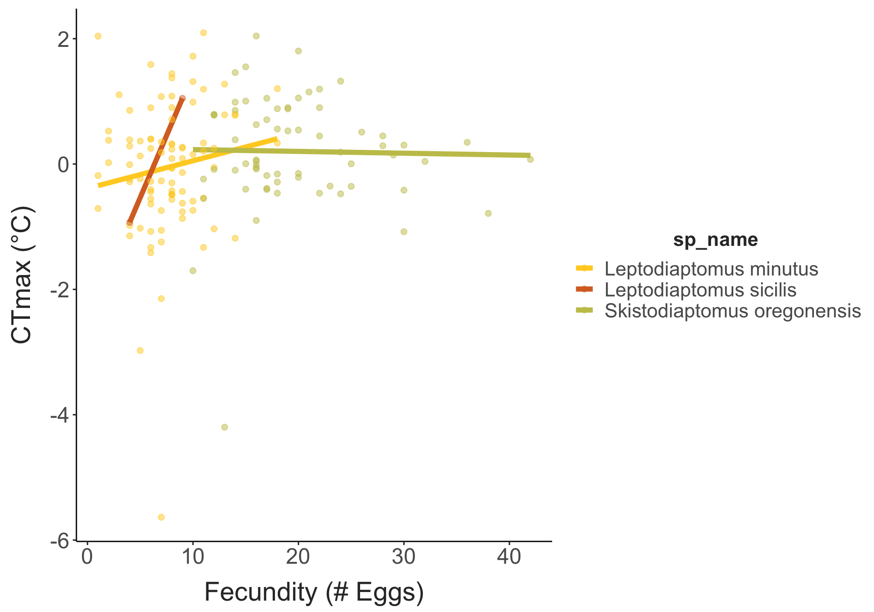
Inter-trait correlations

Slide 10
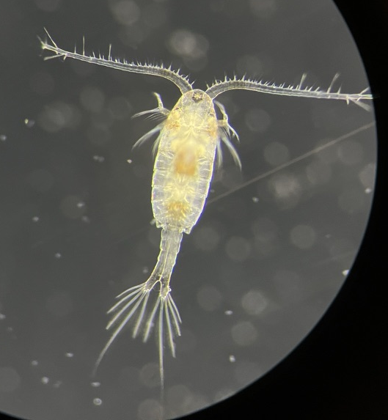
Tangents
Osphranticum - First observation in Lake Champlain

Slide 11
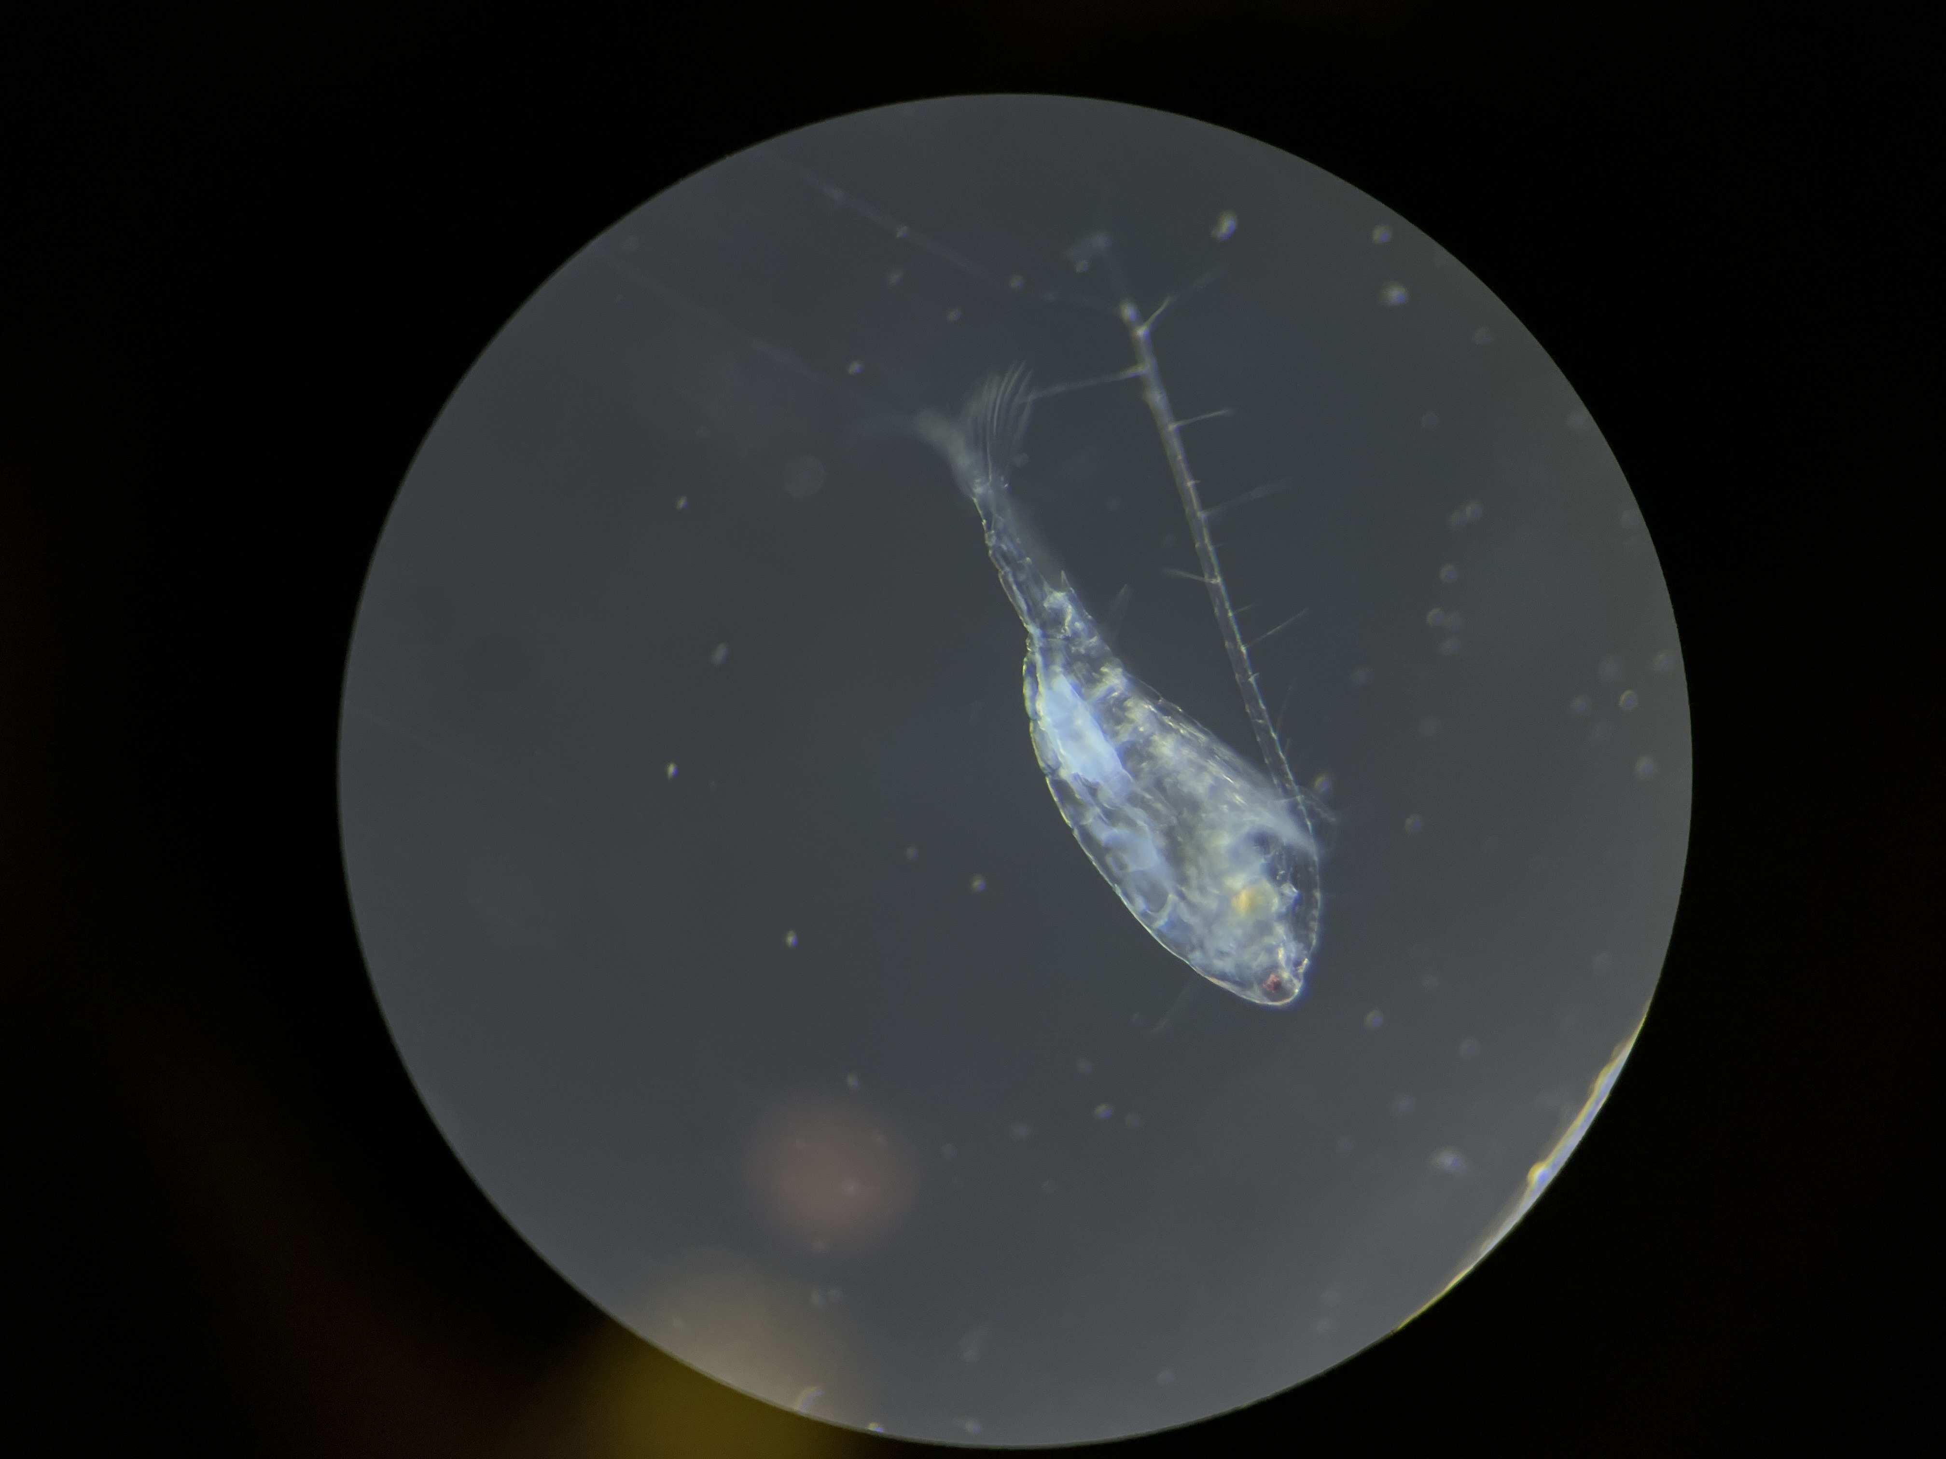
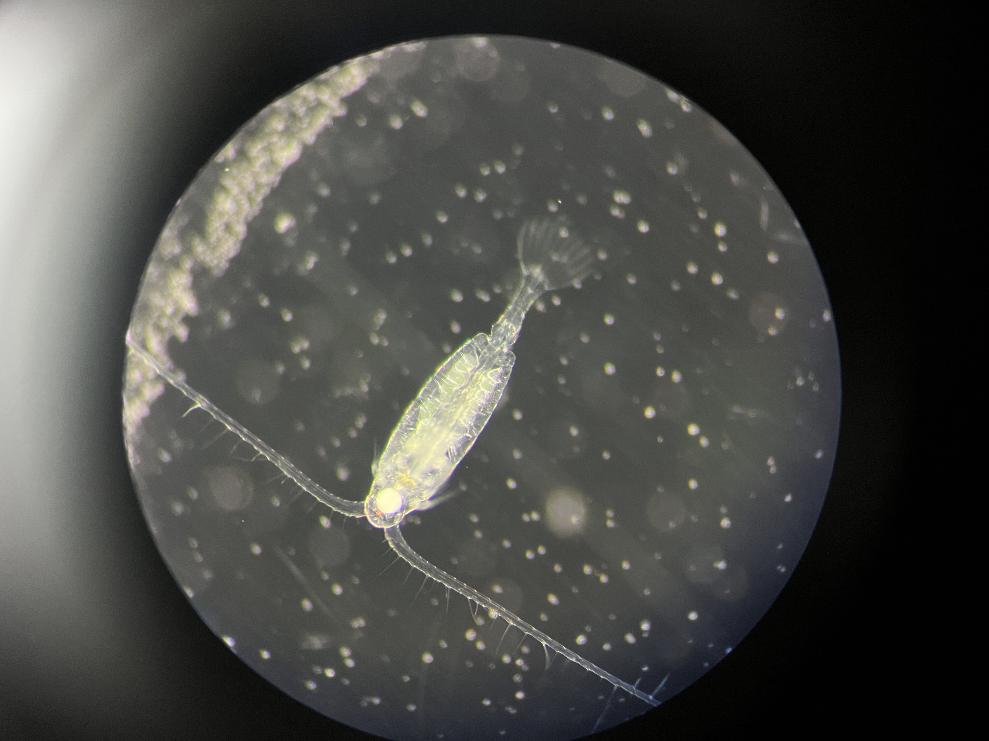
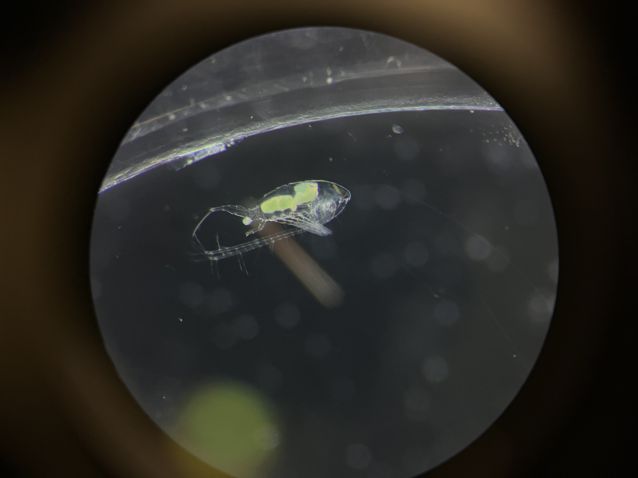
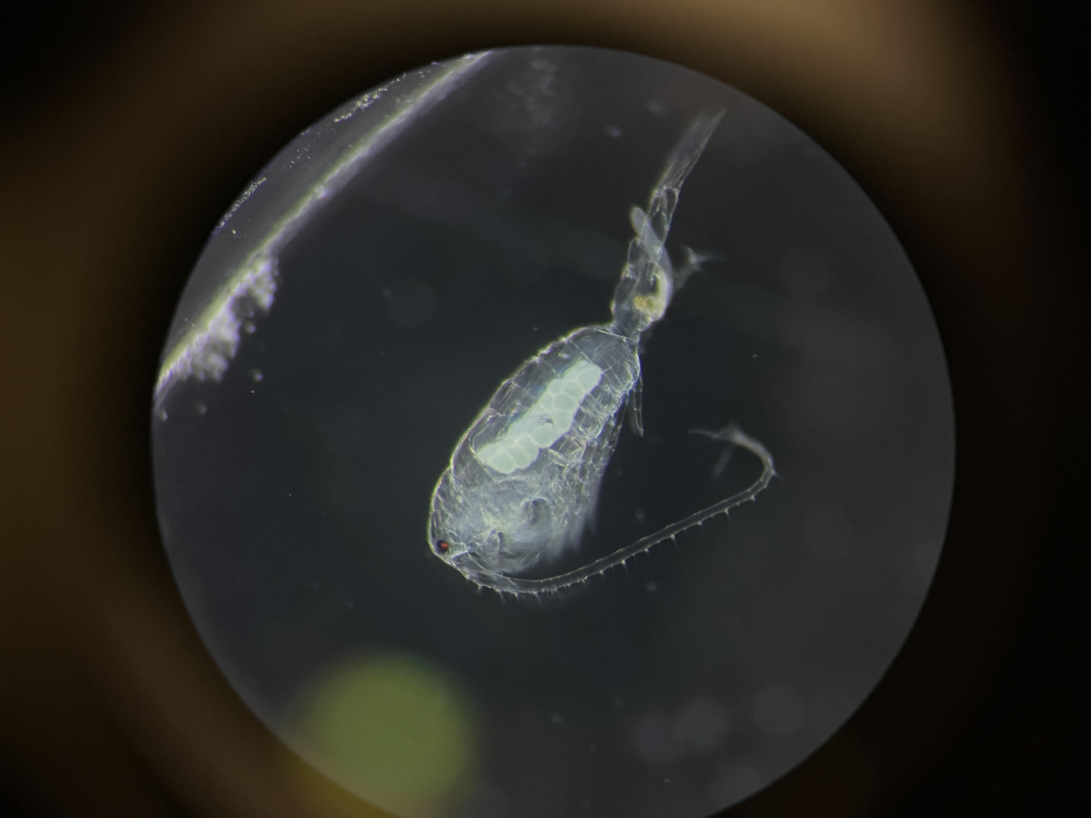
Next steps
Osphranticum note (molecular data, range synthesis, etc.)
Egg size data from images
‘Infected’ and ‘Producing eggs’ status from images
Salinity stress
Interactive dashboard
Your ideas!

